Slide 1





Starbucks
Starbucks
“Every great solution starts with a good cup of coffee.”
Presented By:
NamaN, Priya, Varuna, Sanjana

Slide 2

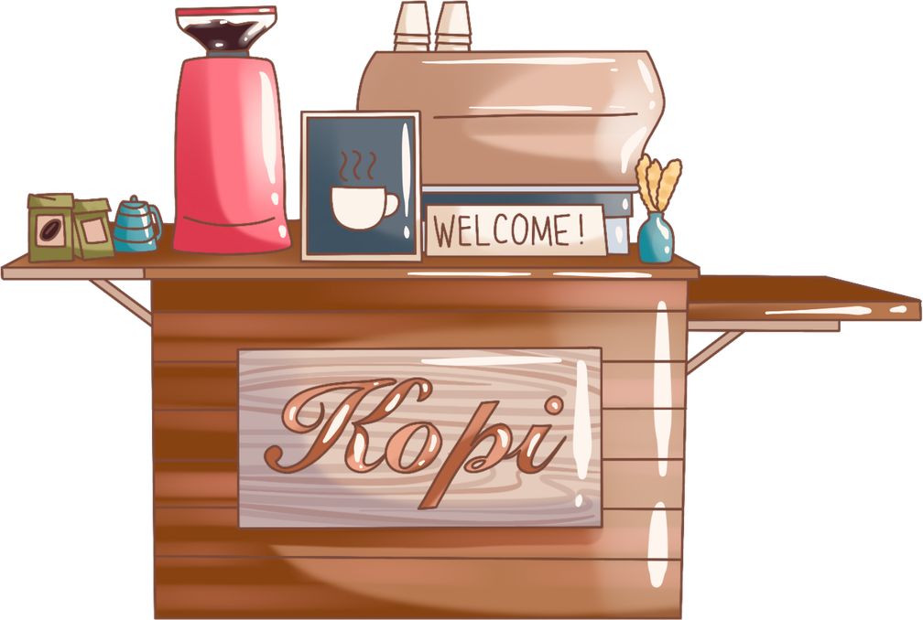
Starbucks Dataset
Starbucks
This dataset is a high - resolution behavioral map capturing the longitudinal purchasing history of 14,988 unique customers. It goes beyond simple transaction logs by tracking the relationship between specific behavioral traits such as customization frequency and visit consistency and total lifetime revenue.
Why we choose this topic
Statistical Significance, Behavioral Depth, Real-World Complexity And,We love Coffee.........

Slide 3

Starbucks
Problem Definition & Research Question
Central Question: What factors drive customer spending at Starbucks?
Sub-questions guiding our analysis:
1. Data Exploration (Naman): What does the spending landscape look like? Which segments show the biggest differences?
2. Correlation & Distributions (Priya): How strongly do cart size and customizations relate to spending? Does spending follow a normal distribution?
3. Hypothesis Testing (Sanjana): Are the spending differences between Mobile vs Non-Mobile and Rewards vs Non-Rewards statistically significant?
4. Probability & Bayes Theorem (Varuna): How rare are high-value spenders? Given a high-value order, who most likely placed it?
Business Motivation:
Understanding spending drivers helps Starbucks optimize its mobile app strategy, loyalty program, and in-store experience to increase revenue per order.

Slide 4
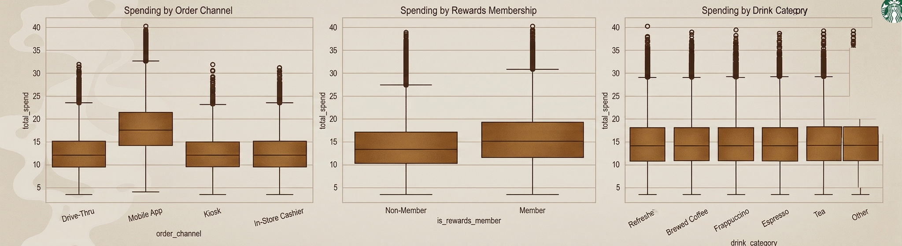
Data Exploration: Descriptive Statistics & Key Segments
Starbucks
Descriptive Statistics (Lecture 1):
total_spend:
Mean = $14.87,
Median = $14.17,
SD = $5.51
Five-Number Summary:
Min $3.51,
Q1 $10.84,
Median $14.17,
Q3 $18.18,
Max $40.31
IQR = $7.34,
Outliers: 1,415 (1.42%) above $29.19
Mean Spend by Segment (the key finding):
Mobile App: $18.08 (42.5% of orders)
Drive-Thru: $12.48,
In-Store: $12.51,
Kiosk: $12.49
Gap: Mobile App is $5.59 above every other channel
Rewards Members vs Non-Members:
$15.72 vs $14.09 (+$1.63)
Age: 18-34 spend ~$15.55, 55+ spend $13.06
Drink Category: No meaningful difference (all within $0.09)

Slide 5
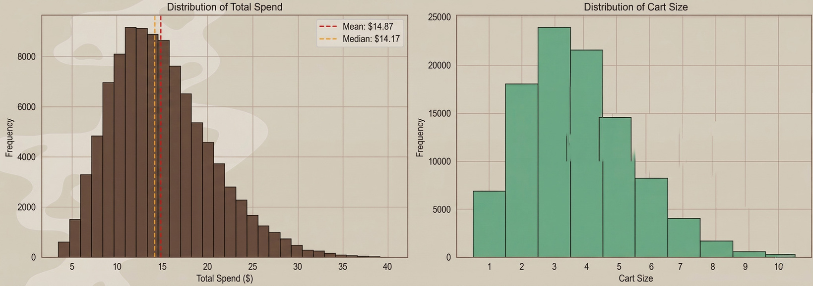
Starbucks
Data Exploration: Descriptive Statistics & Key Segments
Key EDA Takeaways:
1. Mobile App is the dominant spending driver ($18.08 vs ~$12.50 for all others)
2. Rewards membership shows a modest effect (+$1.63), needs hypothesis testing
3. Drink category and store location have no meaningful effect on spending
4. Data quality is excellent: zero missing values, low outlier rates
5. These findings set the stage for all subsequent analyses
Distribution shape: Roughly symmetric with slight right skew
Mean ($14.87) close to Median ($14.17) confirms near-symmetry
Most orders fall between $10 and $20

Slide 6

Starbucks
Covariance & Pearson Correlation
“Covariance shows direction, while correlation shows both strength and direction on a standardized scale.”

Slide 7
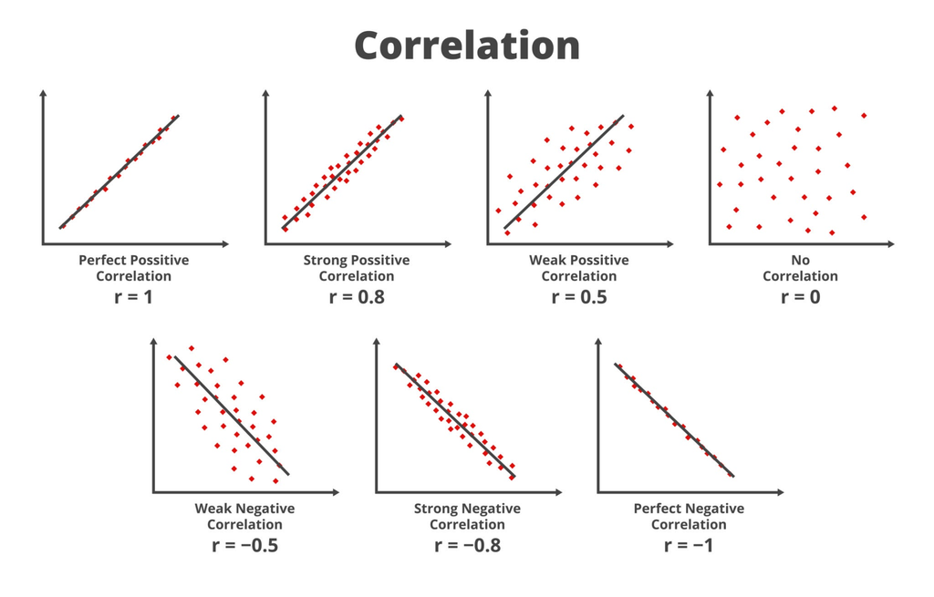
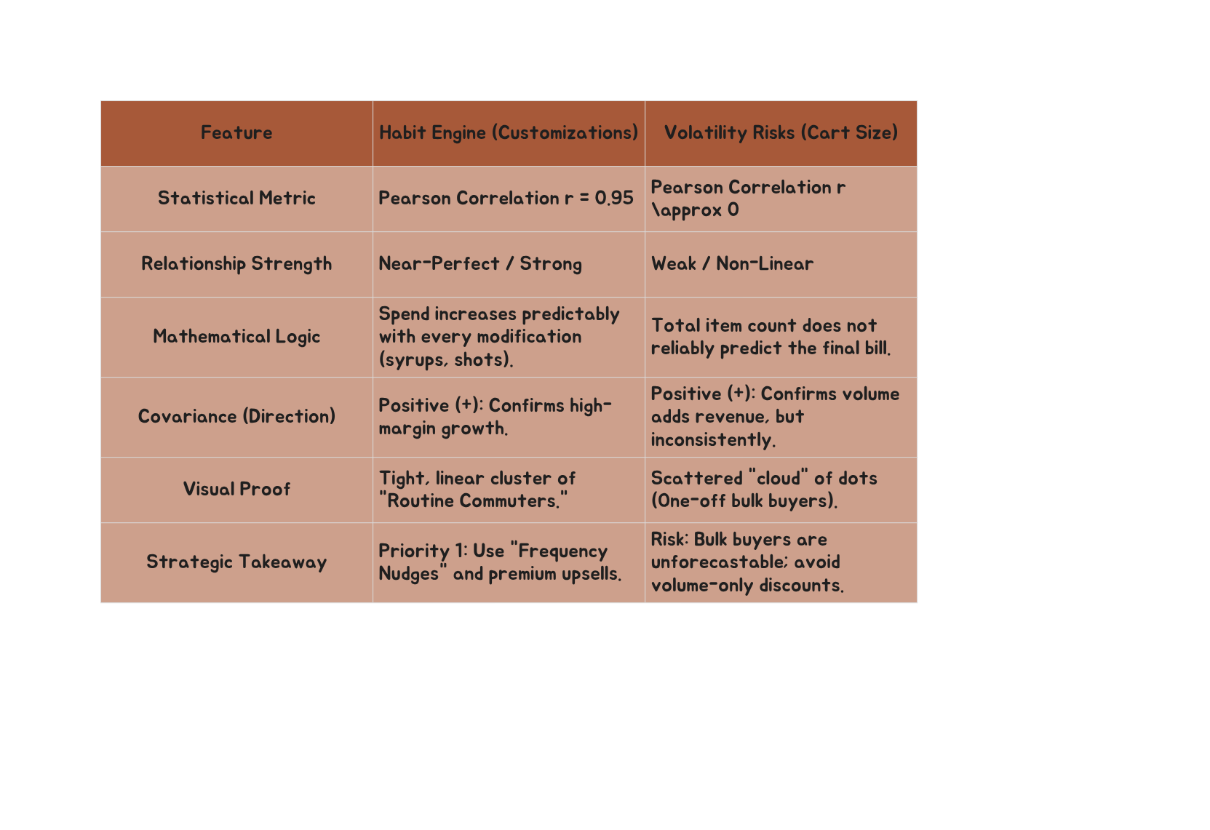
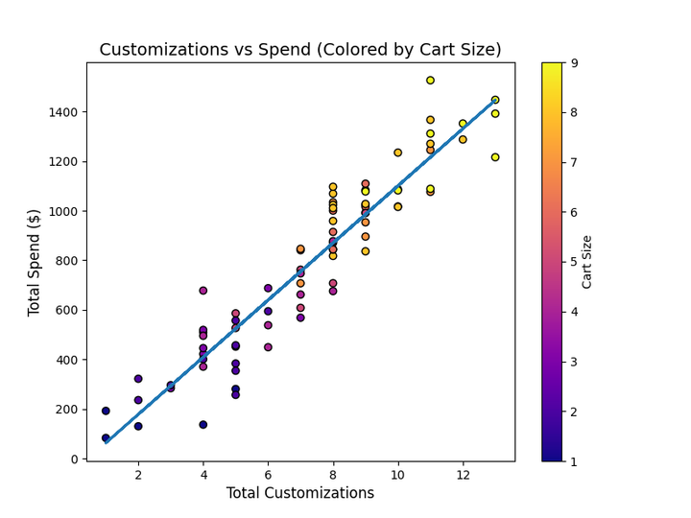
Covariance and Pearson correlation-How strongly do cart_size and num_customizations relate to total_spend?
Starbucks
Business Insight-"Revenue growth is driven more effectively by upselling premium
modifications (customizations) rather than just encouraging customers to buy more items per visit (cart size)."

Slide 8
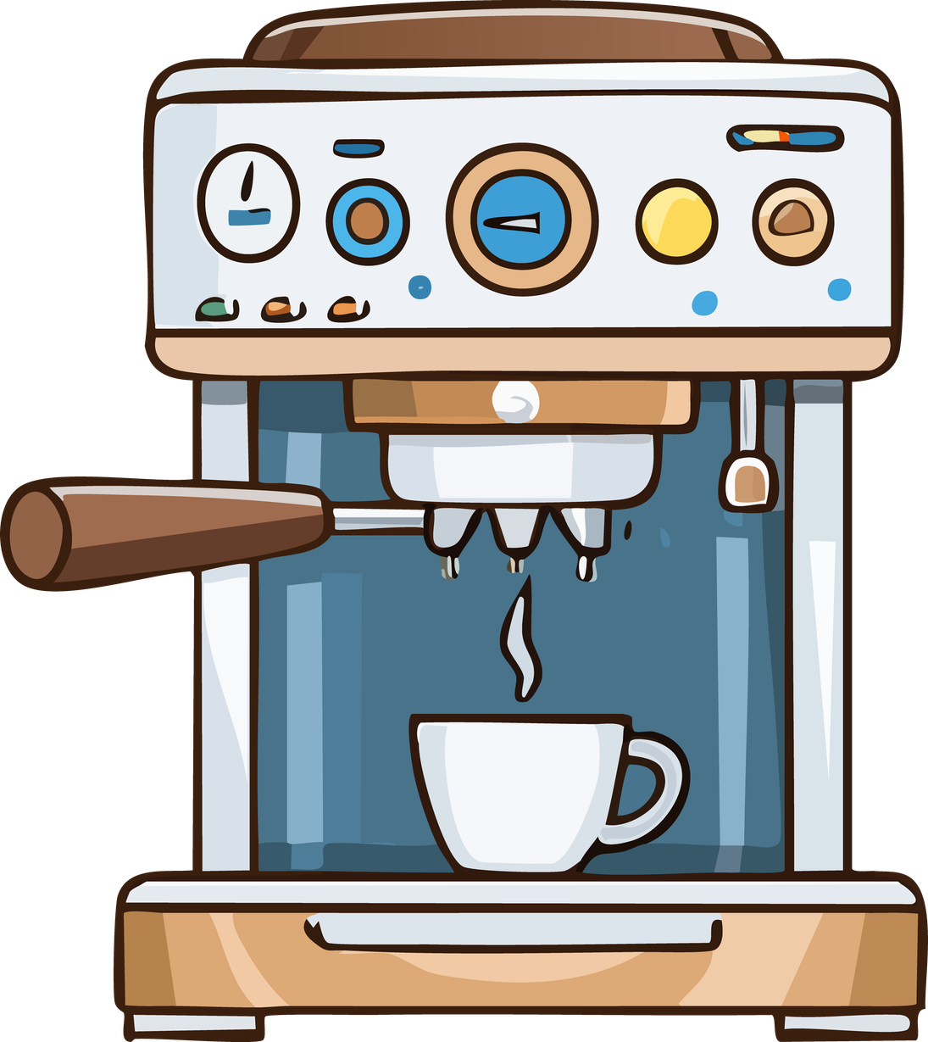
Starbucks
chebyshev’s Inequality Vs Empirical Rule
"Chebyshev provides a mathematical certainty;
The Empirical Rule provides a precise estimate. "

Slide 9
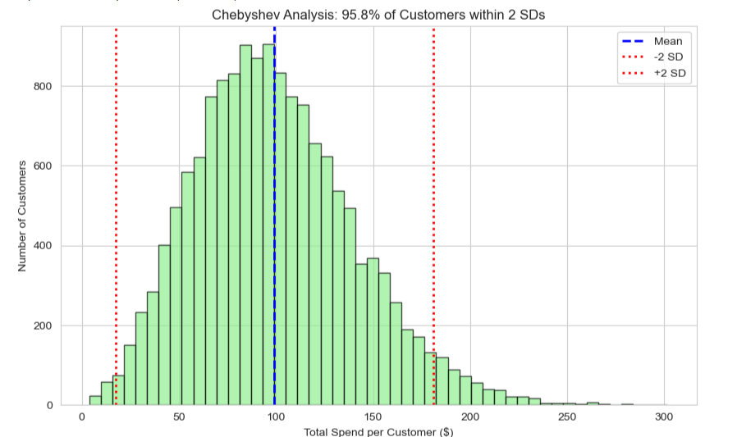
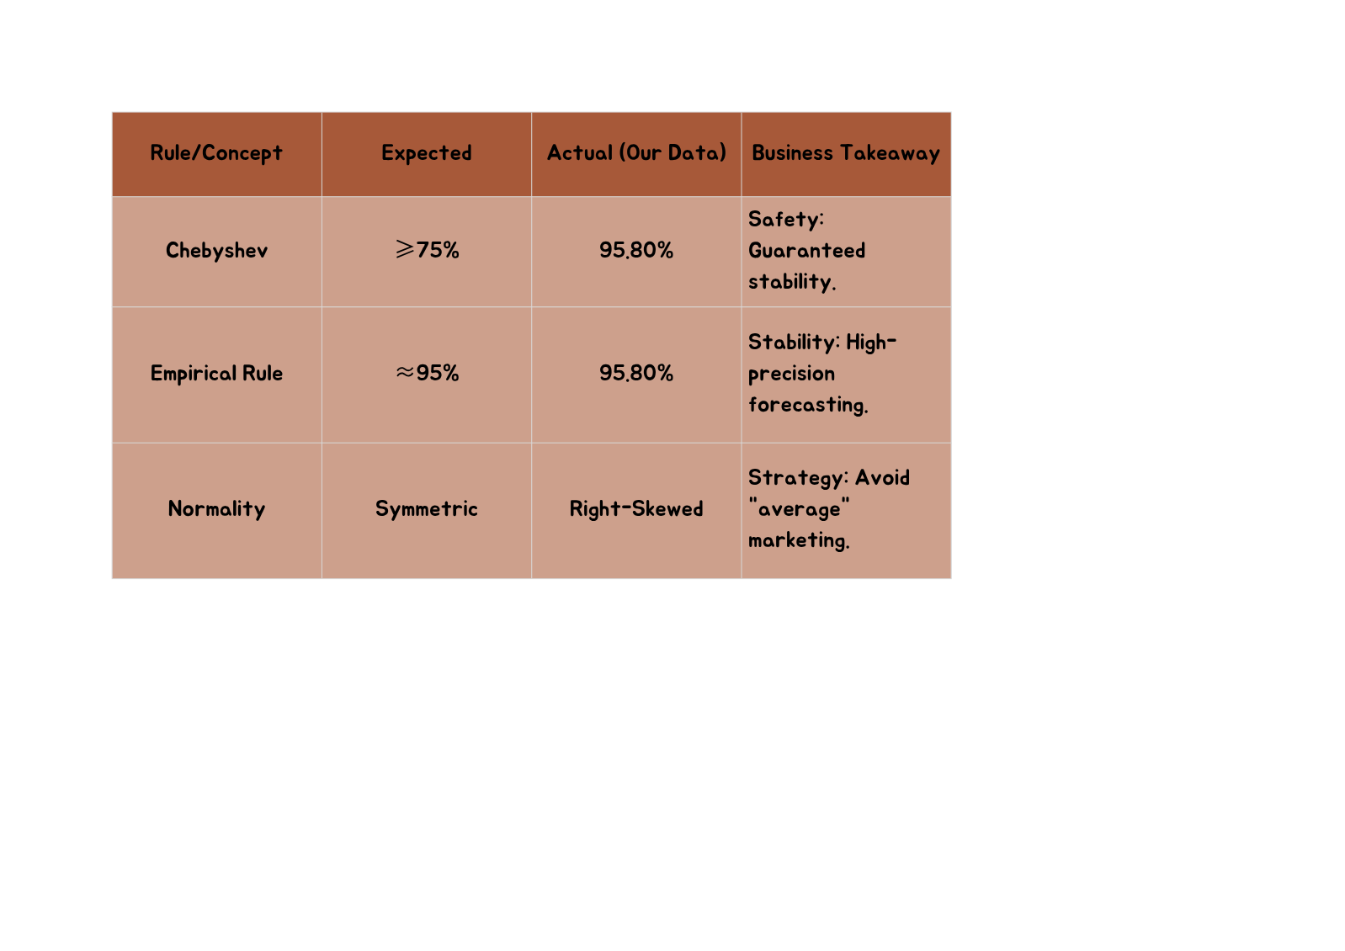
Analysis 2-Chebyshev's inequality-What % of spending falls within 2 SDs? Compare with empirical rule
Starbucks
Business Insight-"We have achieved a 'High-Confidence' Revenue Model. Even though the math (Chebyshev) only requires 75% stability, our actual customer data hits 95.8%. This beats the standard 95% Empirical Rule and proves that our financial future is not at the mercy of a few 'Whales' or outliers. Our core business is steady, predictable, and ready to scale."

Slide 10
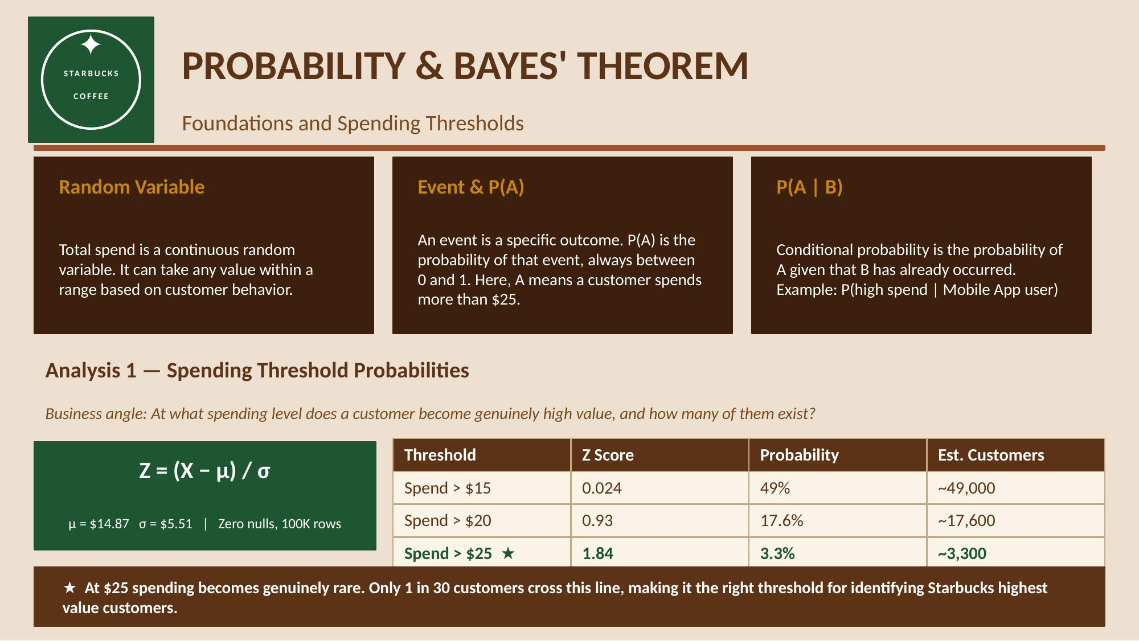
Starbucks

Slide 11
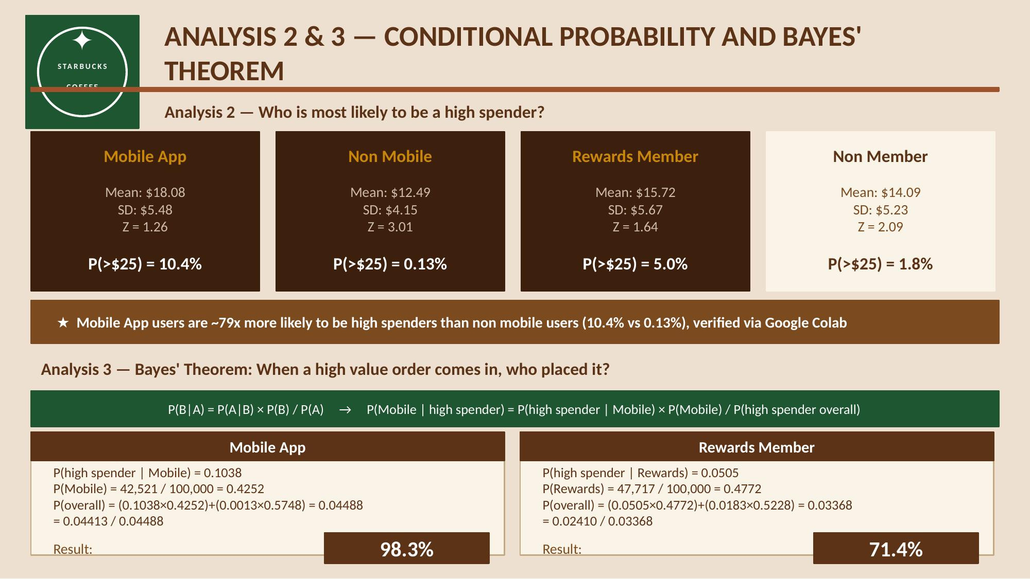
Starbucks

Slide 12
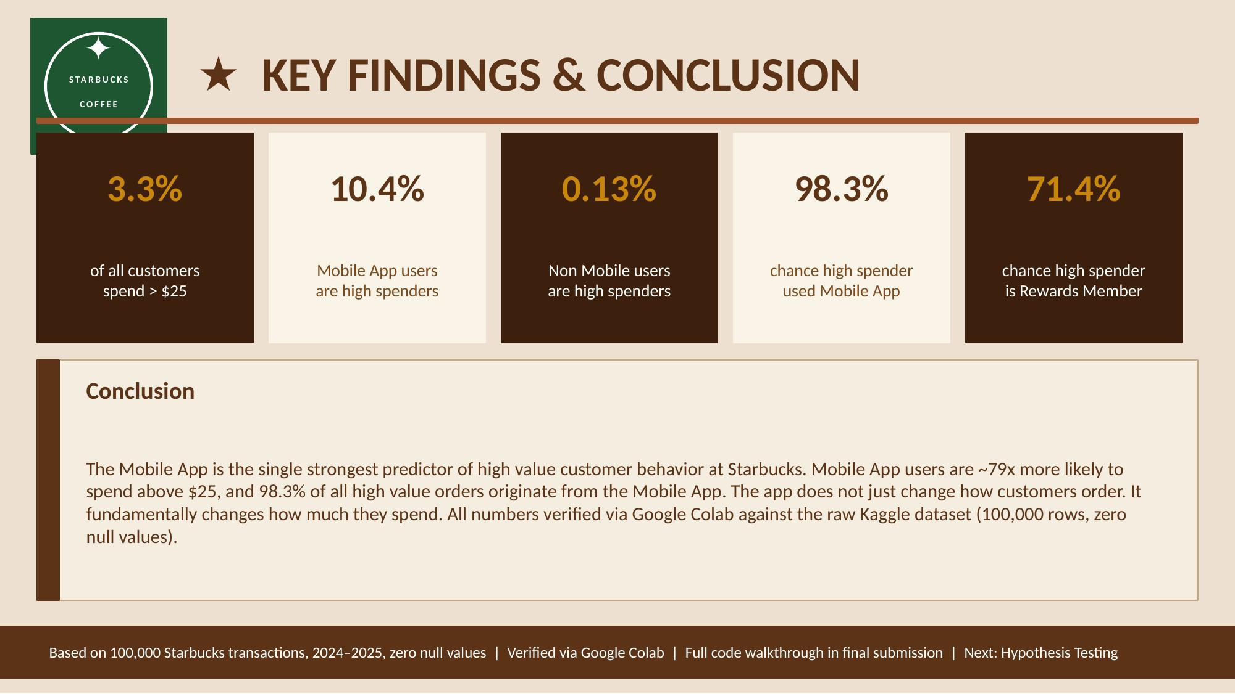
Starbucks

Slide 13
Starbucks
Hypothesis Testing
A statistical method used to determine whether observed differences in data are statistically significant or due to random chance.
Aids in making informed, data-driven decisions.

Slide 14
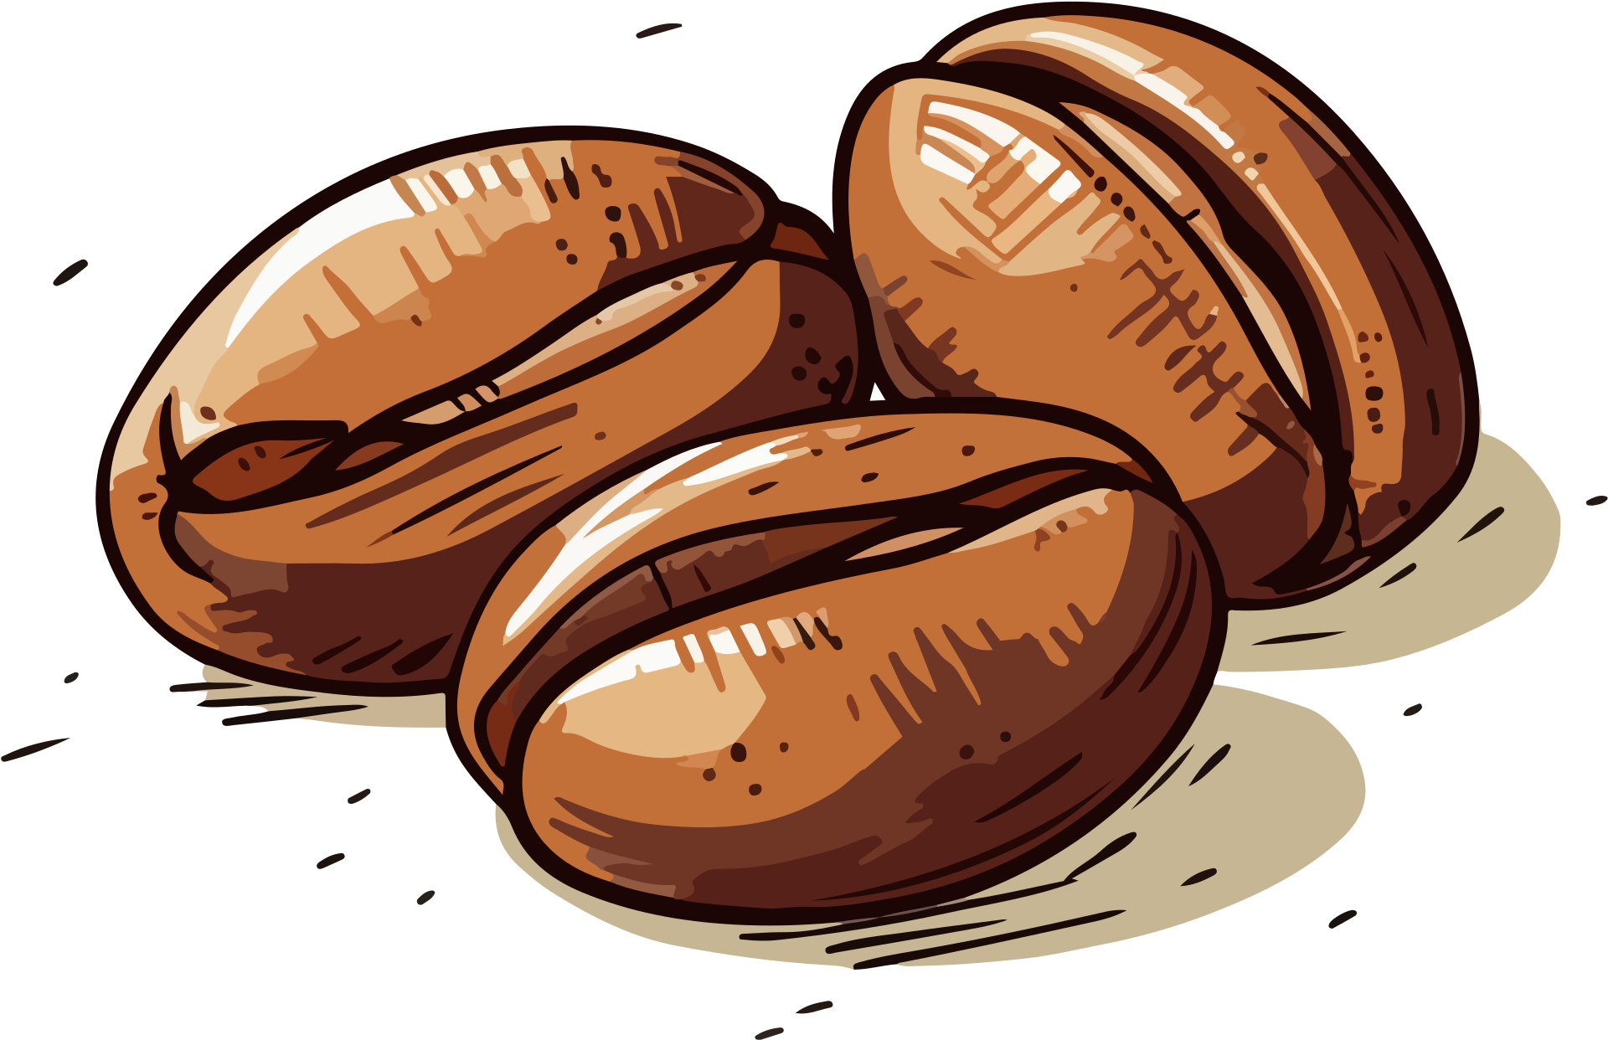
Starbucks
Question
Do customers spend differently based on:
Order Channel - (Mobile vs Non - Mobile)?
Rewards Membership - (Yes vs No)?
Why are we using it?
To validate if observed differences in spending are statistically significant
Not just based on averages, but mathematically proven
Define Hypotheses
Mobile vs Non-Mobile And Rewards vs Non-Rewards
H₀: μ₁ = μ₂
Hₐ: μ₁ ≠ μ₂
Test Used:
Independent Two-Sample t-test
α = 0.05

Slide 15
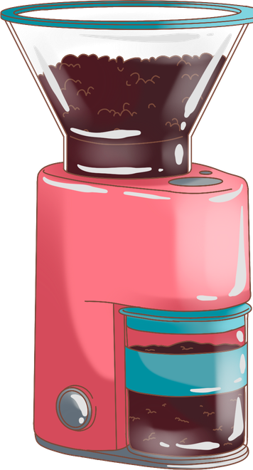
Starbucks
Results & Interpretation
Mobile vs Non-Mobile
Mean: 18.08 vs 12.49
t = 175.91
p-value < 0.0001
Reject H₀
(Null Hypothesis)
Mobile users spend more
Rewards vs Non-Rewards
Mean: 15.72 vs 14.09
t = 47.08
p-value < 0.0001
Reject H₀
(Null Hypothesis)
Rewards members spend more
Differences are statistically significant

Slide 16
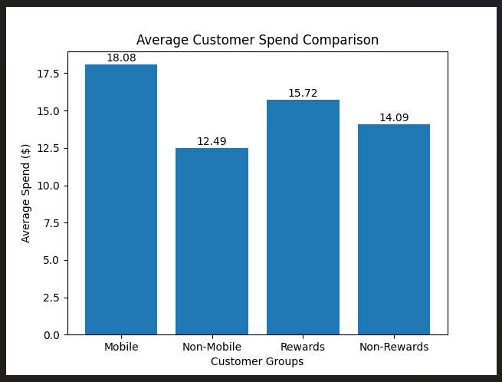
Graph representation
Starbucks

Slide 17

Next Steps & Remaining Work
Starbucks
What we have completed:
Data Exploration & Descriptive Statistics (Naman)
Correlation, Covariance, Chebyshev’s inequality Vs Empirical Rule (Priya)
Probability, Conditional Probability & Bayes Theorem (Varuna)
Hypothesis Testing: Two-sample t-tests for Mobile vs Non-Mobile and Rewards vs Non-Rewards (Sanjana)
What remains for the final submission (May 5):
Additional hypothesis tests (paired t-test for repeat customers, two-proportion z-test)
Confidence intervals for mean spend by segment
Full academic report in LaTeX (10-12 pages, double-column, J-NaNA format)
YouTube demo recording (12-15 minutes)
Deployment discussion: how findings translate to actionable business strategy
Consolidate all code into final Jupyter notebooks

Slide 18
Starbucks
“Thanks a latte ☕”

